Slide 1
LatentView Capabilities in Enabling Data Driven Ecosystem
January, 2019

Slide 2
Agenda
1
Overall Solution Approach
2
Design Considerations & Challenges
3
Solution Architecture & Case Studies
4
Analytics Layer & Case Studies
5
AI / ML Layer & Case Studies

Slide 3
Overall Solution Approach

Slide 4



Overall Solution Approach
Key questions that need to be addressed
Data Lake Creation
Analytics Engine
1
2
3
How to acquire data?
How to create a unified data view?
How to enable consumption?
Identify the correct tools to combine data from different sources based on the data type
Prioritize between clouds based platform vs an on premise data lake creation, based on business requirements
Enable support for Visualization or Machine learning techniques like Forecasting, clustering and other advance analytics

Slide 5
Design Considerations & Challenges

Slide 6
Ideal Data Platform – Design Considerations
Ingestion & Storage
Data Variety
Mostly Structured
Disparate systems for Unstructured
Traditional ETL
Data Volume
Limited Capacity
On Premise Considerations
Scheduled Archival & Restoration
Transformation
Data Veracity
Data Silos
No central view of metrics
Lack of metadata and lineage
Data Velocity
Tightly coupled dependencies
Cascading failures
Information Delivery
Analytics Workloads
Data Warehouse for all use cases
Reporting
Advanced Analytics by Business
Throttling usage
Access restrictions impacts lead time
Enablers
Process – SLAs
Technology – On-premise, Cloud, Hybrid
Cost – Accountability & Process Transparency
Deployment – Prototype to Production
Data Governance & Security
ACLs

Slide 7
Challenges/Complexity in Unifying Data
Technical Challenges
Environment (Cloud / On-Premise)
Architectural Design
No. of Users
Processing Time
Enabling A/B testing environment
Enabling Change Management
Data Duplication
Mapping / Connecting data
Data Coverage
No maintenance of Infrastructure required
No high investment required: Pay by usage
Highly scalable
Data centralization-Effective data collaboration
across cross-functional teams
Improved business agility and operational efficiency
resulting in competitive edge
Helps in improving the time to launch of campaigns
Automatic software updates
Pros & Cons of Data in Cloud
Security issues: IT team’s guidance necessary to keep it safe
Incompatibility with current software & applications
Lack of support, unplanned outages from cloud providers is sometimes a grey area

Slide 8
Solution Architecture & Case Studies

Slide 9
Business Focused and Workload Centric Architecture
How to acquire data?
How to create a unified data view?
How to enable consumption?
CANNED REPORTS
Data Integration
Relational Data Store
(Ex: AWS Redshift)
Enterprise Reporting Platform
Conventional Data Sources
Structured
Data Lake
(Example: S3)
SELF SERVICE BI
Unconventional Data Sources
Indexing and Querying
(Ex: Elastic Search)
API endpoints
OPERATIONAL
External Data Sources
Unstructured
Machine Learning Workbench
ADVANCED ANALYTICS
Distributed Processing
Feature Engineering
Data Sampling
(Ex: Spark)
Internal Data Sources
Real time Indexing
(Ex: Elastic Cache)
REAL TIME REPORTING
Workload Aware Compute
Data Type specific ETL toolset
Isolating Compute from Storage
9

Slide 10
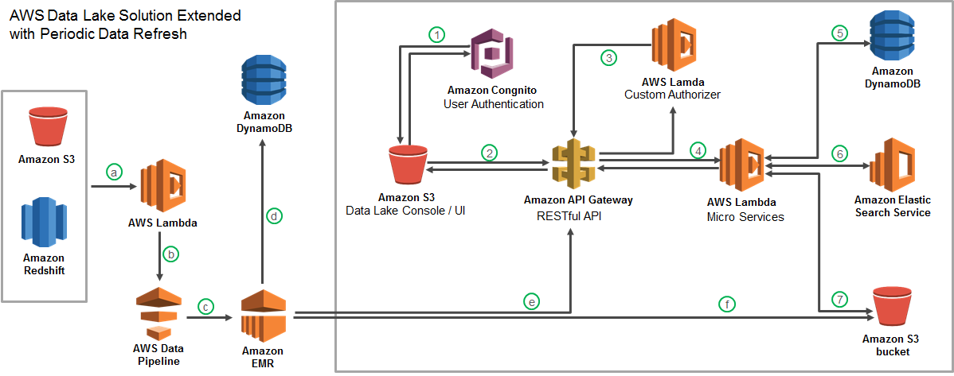




Cloud-based Data Lake to Enhance Analytics Operations
Largest Food Distributor in the US
The Problem: Ageing legacy Business Analytics Infrastructure with high cost of ownership slowing down realizable analytics value
The “Before” State
LatentView Solution
The “After” State
Business users faced significant delays in accessing and analyzing data and had difficulty in handling large volumes of data for analytics
Migrated 60TB of data from legacy systems into a cloud based data lake with extended periodic data refresh which supports reporting and advanced analytics solutions
Reduced cost of ownership and increased throughput of cloud hosted analytics solutions
Recommendation Engine
Order Anomaly Detection
Product Substitution
Revenue Management Use Cases
10

Slide 11
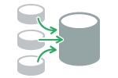
Creating DataMart for All Analytics Use Cases
Leading American multinational computer software company
Business Objective
To build better customer relationships and acquire new customers by segmenting their customer base
To create a DataMart for Analytics use cases like developing a look-a-like model and understanding the changing customer base
LatentView Solution
Created a DataMart with internal variables of Adobe for 1.4M customers
A single table was produced as final output with 6M records consisting of ~2K fields for all analytics use cases
Production environment was materialized to run daily in Hive using Oozie
Benefits & Output
Adobe was able to develop a look alike model for the segments created
Customer base was finally classified under segments based on demographics, characteristics, session level info, web analytics data and marketing response
Challenges
Customer ID’s had duplication issue across multiple countries
Not all ID’s were mapped with multiple data sources
Metrics were repeated across tables for which the resource intensiveness and the coverage of the metric were considered to overcome the issue
Data Sources
Data Mart
Final Segments
Acxiom Data
Creative for pay + Creative Climbers
Fame and Fortune
Utilitarian
Private Hobbyist
Applause Seekers + Engaged Expressive
App Launch Details
Email Domain Details
Feature Level Data
Marketing Responses
Web Analytics Data
Notes:
Adobe

Slide 12
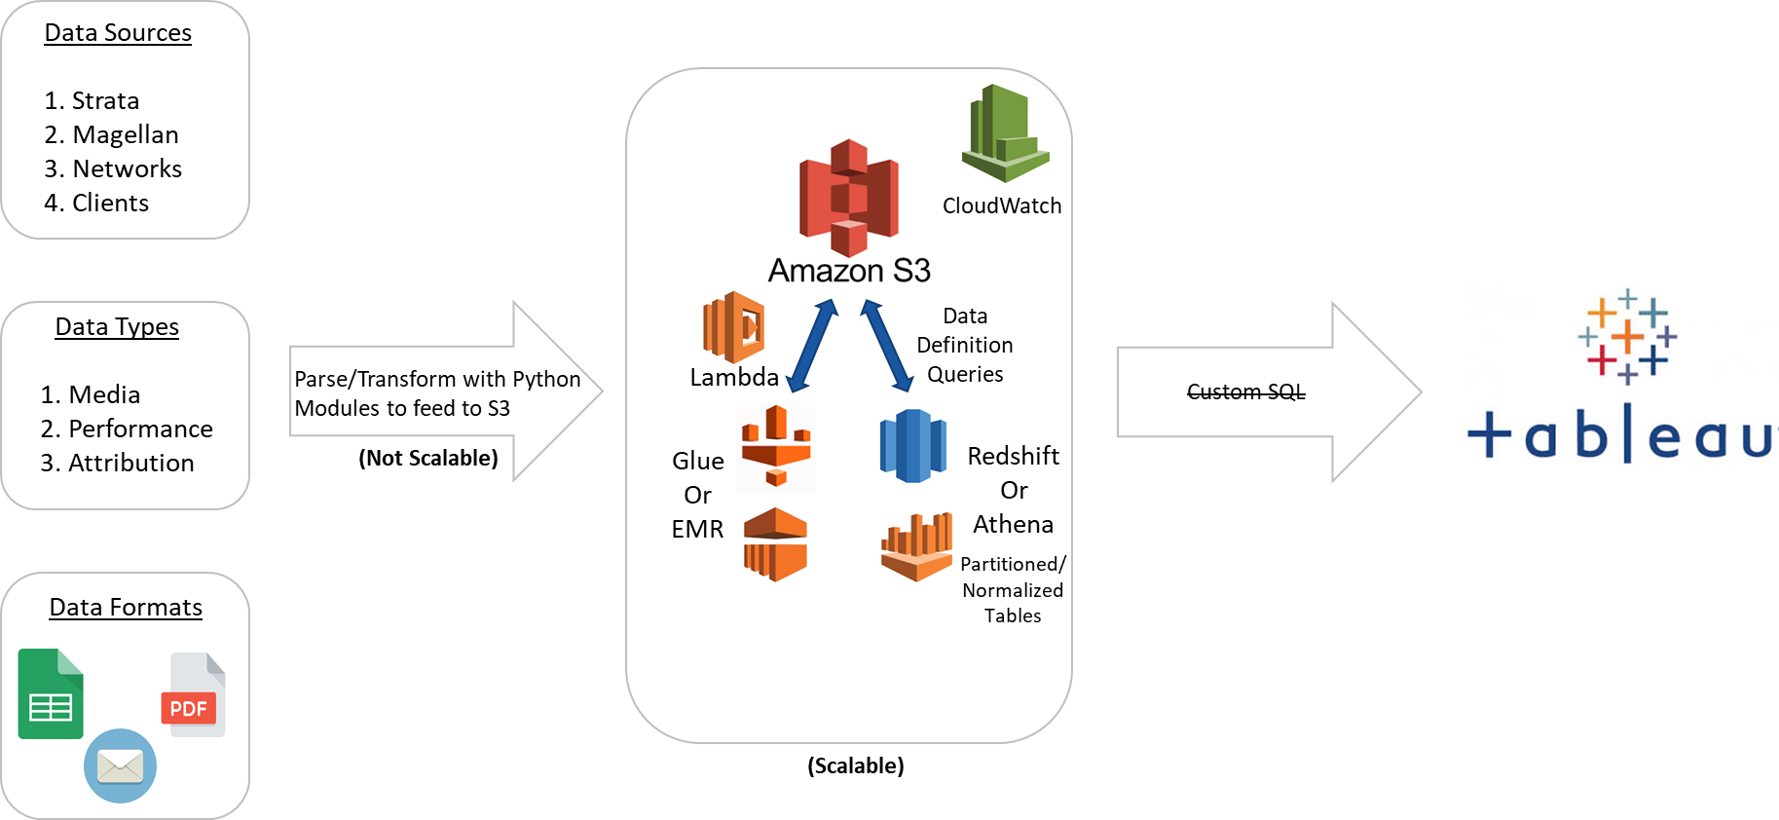
Centralizing Media Data from Media Buying Platforms
For a leading client in Advertising and Marketing industry
The Problem: Lack of data quality, management and governance leading to heavy dependence on analysts’ manual efforts for weekly reporting
The “Before” State
LatentView Solution
The “After” State
Business users faced significant delays in on boarding and publishing reports. Ad-hoc analysis were not supported to a larger extent
Centralized, Cloud based and Scalable approach was introduced and implemented. Normalized Database design – Dimension Data Model
Dashboard timeliness reduced from 24 hours to less than 30 minutes reducing 50% cost of development
Reduced 80% of manual work and dependence of analysts
Business Benefits
Collect and store any type of data, at any scale, and at low cost.
Secure the data and prevent unauthorized access
Catalog, search, and find the relevant data in the central repository
Quickly and easily perform new types of data analysis, predictive analytics, artificial intelligence (AI), and machine learning
Notes:
Oxford Road
Oxford Road producing and placing ads on traditional media channels like television, terrestrial and satellite radio, new media channels such as streaming audio and video, and on-demand content like Podcast and Video On Demand(VOD).
Requirements
Centralizing media data from Media Buying Platforms (Postlog, Strata)
Appending performance data from Google Analytics, client e-mails
Enriching data from third party data sources
Automation of Data Loading and Report publishing
Challenge
Company wide data silos
Lack of data quality
Lack of data management and governance
Heavy dependence on analysts’ manual efforts for weekly reporting
Issues with the Current System
Timeliness – More time on client on boarding and reports publishing `~ 24 Hours – Manual Process
Flexibility – Not supporting ad-hoc analysis
Quality – No Data Model and Lineage
Findability – Hard for Non-IT people/ Business Analyst
Scalability – Unable to process the large volume of data
Advantages of our Solution
Centralized, Cloud based, Scalable approach
Normalized Database design – Dimension Data Model
Modular Codes
Configurable externally
Other Key Benefits:
Dashboard timeliness reduced from 24 hours to less than 30 minutes.
Reduced 50% cost of development and testing using local development environment
Reduced 80% of manual work and dependence of analysts
Collect and store any type of data, at any scale, and at low cost.
Secure the data and prevent unauthorized access
Catalog, search, and find the relevant data in the central repository
Quickly and easily perform new types of data analysis, predictive analytics, artificial intelligence (AI), and machine learning.

Slide 13
Analytics Layer & Case Studies

Slide 14
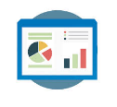




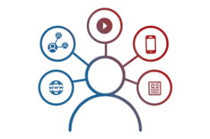


Making Sense of the Data
Reporting & Visualization
Performance Management, KPI Measurements
Monitoring & Control
Real Time Assurance, Audit & Compliance
Voice of Customer
Criticalities, Competitive Intelligence
Segmentation & Clustering
Personalization, Appropriateness etc.
Relationship & Causalities
Implementation, Strategy &
Prioritization
Digital Analytics
Consumer Journeys, Marketing Effectiveness
Experimentation
Experimentation at scale, A/B testing etc.
Integrated & Disparate sources in Data Lake

Slide 15



Drivers for Data Visualization
Who is my audience
Visual discovery of insights
Scalability
Usability
Summary to detailed reporting
Tracking right KPI’s
What is the no. of users
Which devices are supportive
Visualize overall summary for an executive level
To drill down for generating insights for operational level audience
Getting the right KPI’s to meet the business demands
Dynamic change in KPI’s for different set of audience
Visualization based on the number of users
Giving access to the authorized set of audience
Developing the visualization supporting multiple use case scenarios
Able to access from Desktop, Tablets & mobile phones

Slide 16













Reporting & Visualization Capabilities
Different forms of Reporting :
LatentView Visualisation Practices
Expertise in developing reports & dashboards using visualization tools like Tableau / DOMO / PowerBI / QlikView
Custom Web Tool development highlighting the key metrics across different sections in the form of an interactive dashboard
Integration of interactive Visualization in the web portals
Mobile Apps development which can help in giving updates on a periodic basis
Structure and Flow
Uncluttered
Integrate Text Graphics and Data
Enforce Comparison
Analysis and Insight Generation

Slide 17




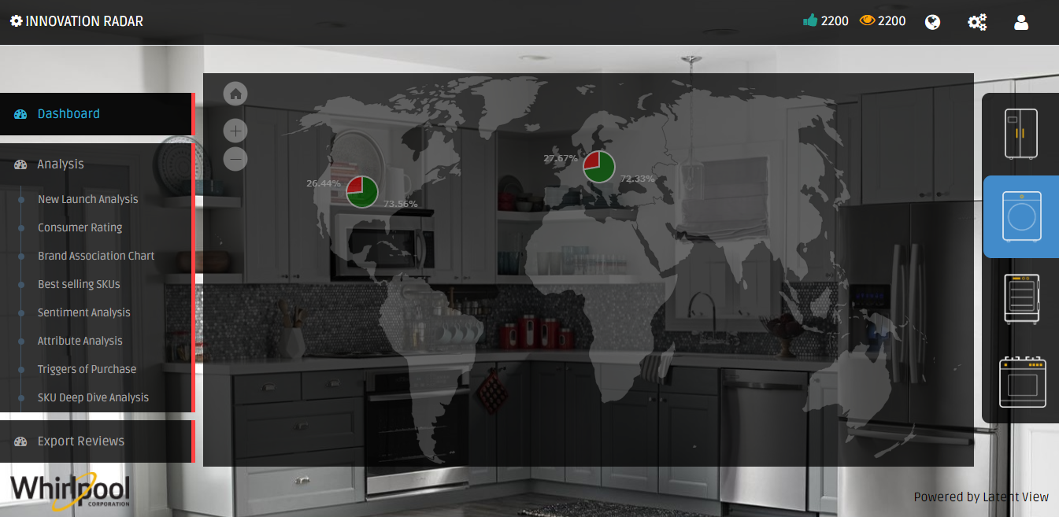





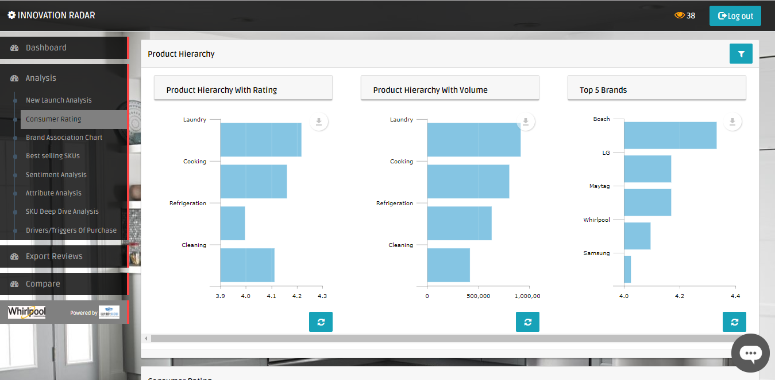



Data driven Product Innovation based on Consumer Reviews
Leading Home Appliances Manufacturer in US
BI Tool : Web Tool
The Problem: Lack of/Delayed access to direct customer feedback on their products and competitors’ can adversely affect a consumer durable company’s ability to innovate and keep customers happy
The “Before” State
LatentView Solution
The “After” State
Purchase drivers were determined by post-facto analysis of POS data at stores and survey data resulting in delays of up to eight months to get consumer feedback on product features
Built a real-time text analytics platform to consolidate external, unstructured data to ‘measure’ customer feedback of client’s brand with respect to competition on various parameters that drives purchase
Precise, fine-tuned innovation on product features and messaging was possible on an ongoing basis as consumer feedback reached the teams directly within 2.5 months of product launch
Sentiment Analysis
Industry Forums
Drivers of Purchase
Data Focus
Triggers of Purchase
Market Places
Int
Ext
Expert Opinion
Unstruct.
Struct.
Consumer Rating
Brand Websites
Popular Features
Data Extraction & Data Landscape
Text Analytics
Dashboards

Slide 18
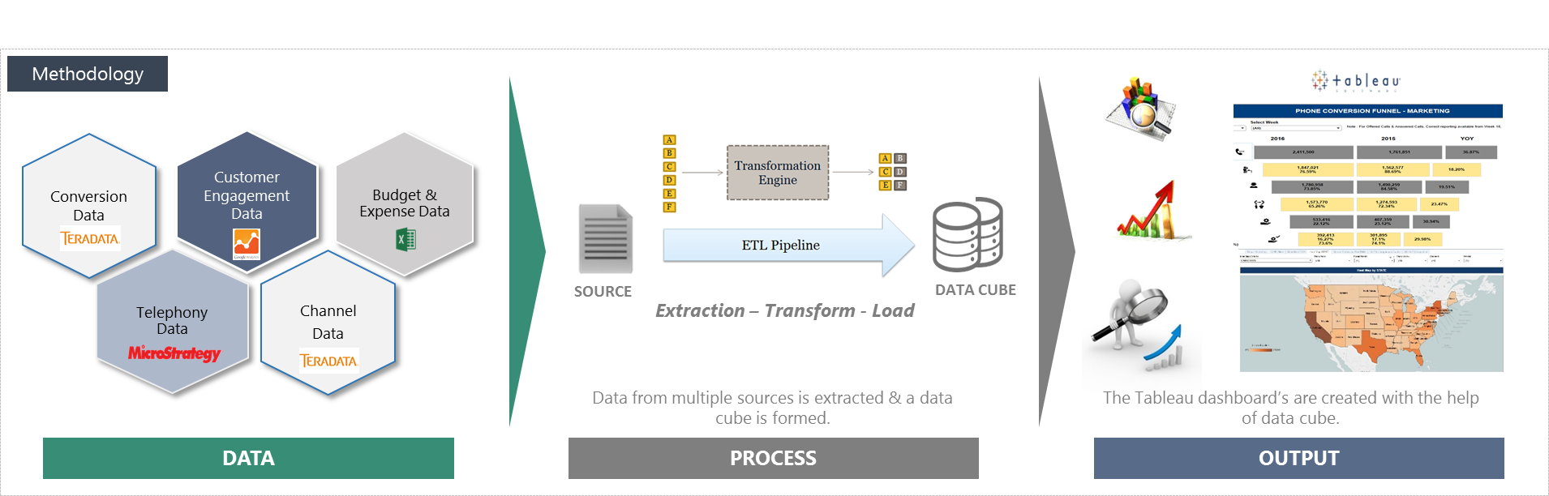
One Stop Conversion Funnel Dashboard from Multiple Sources
Leading Home Appliance Repair Service Provider in US
The “Before” State
Clients were in needs of a visualization solution for the Marketing & Non Marketing channels
To enable descriptive analytics and provide Visualization solution for Marketing team and to help in Strategic decision making
LatentView Solution
Created a data lake by extracting data from multiple data sources and developed tableau dashboard’s & reports tracking the conversion funnel
The dashboard provides Marketing KPI's at a channel level across geographies on a weekly basis comparing YoY performance.
The “After” State
The Conversion funnel helped in understanding the flow of business and identified bottlenecks & areas of concern
The Marketing team understands the business trends and seasonality of various Channels across geographies

Slide 19
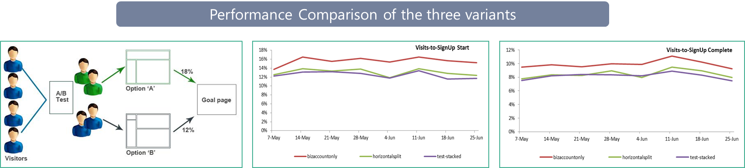
A/B Testing for a Global Online Payment Solutions Provider
Leading Online Payment Solutions Provider
The Business Objective
Improve Merchant account acquisitions by providing a easy-to-use page layout on the website
Alternatively, test the performance of three variants of the same Page (with different layouts), live at the same time
LatentView Solution
Established the homogeneity of traffic to the variants of the page to isolate bias Analyzed the performance of the pages in terms of conversions and engagement using Site catalyst, Google Analytics & SQL
Regular tracking to establish consistent and significant performance improvement
Business Benefits
Analysis resulted in identifying the page which results in highest merchant account acquisitions and activation
13% increase in activations within 60 days of account signups from the Winning variant compared to the Control

Slide 20
AI / ML Layer & Case Studies

Slide 21



AI / ML to Drive Business Impact
Business Planning
Demand Prediction
Market Strategy
Strategic Investments
Early Warning Alerts
Customer Complaints
Transactional Risks
Loss Prevention
Innovation / Insights
Voice of Consumer
Competitive Intelligence
Product Governance
Customer Engagement
Personalization
Acquisition & Conversion
Customer Experiences
Self Serve Analytics through Micro Applications
Complex Data Linearly Scalable With Data Volume
Faster Time To Market Due To Less Set Up Time
Artificial Intelligence / Machine Learning
Integrated & Disparate sources in Data Lake

Slide 22

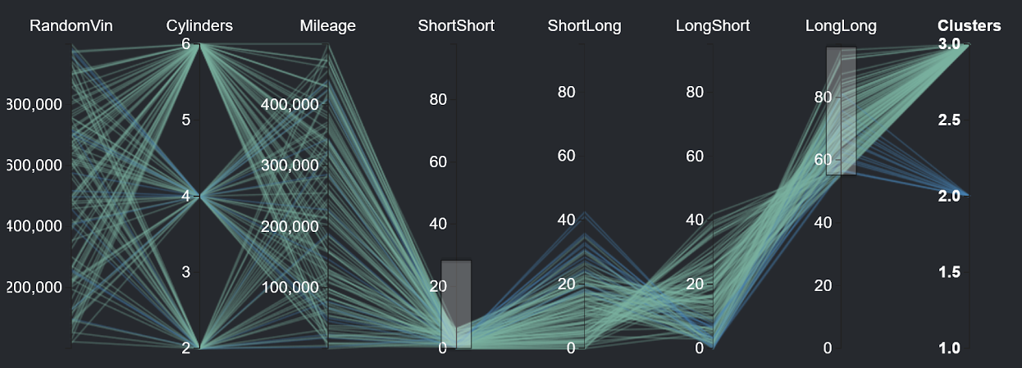
Risk Identification By Modeling Customer Behavioral Patterns
Europe-based Iconic Automobile Manufacturer
The Problem: Costs incurred due to warranty claims had a negative impact of almost 2.5% on the bottom line
The “Before” State
LatentView Solution
The “After” State
Warranty claim predictions were based on an historical average computed across all categories of drivers
Driving styles were identified based on vehicle usage and historical warranty claims which were then used to accurately predict future claims for each driving style
Warranty costs reduced by 35% for the “long pause and short trips” driving style due to proactive ‘drive right’ messaging communicated to at-risk drivers
Controller Readout Data
Hypothesis Testing Tool
Output
C1 – > 30K/Yr, 30% Long Trips, 25% - Acceleration > 200KMPH
Typical Issues:
Head Gasket Failure, Soot in the oil, Engine mount issues
Calculated Risk: €2.400,00
Risky Clusters: C2, C6
Cause: High Acceleration in winter without heating
Notes:
BMW – Hypothesis Testing
Business Objective:
Improve the throughput in production line for a plant having Operational Equipment Efficiency (OEE) due to impact of packaging segment stops contributing to fryer downtime / throughput reduction
LatentView Solution:
Driving Styles
Identify key driving styles using the vehicle controller data
What are the main driving styles?
Warranty Claims
Compare driving styles with warranty claims data
Are there claim patterns to individual styles?
Automated Hypothesis Testing
Use the tool to identify risk groups by dynamic profiling
Continuous Hypothesis Testing
Process:
Data collected:
1) Vehicle Usage from Connected Data - Driving Styles
2) Warranty & Repair Data - Repairs & Risk Patterns
Output:
Driver Segmentation, Risk Prediction & Maintenance at each Car (VIN) level

Slide 23
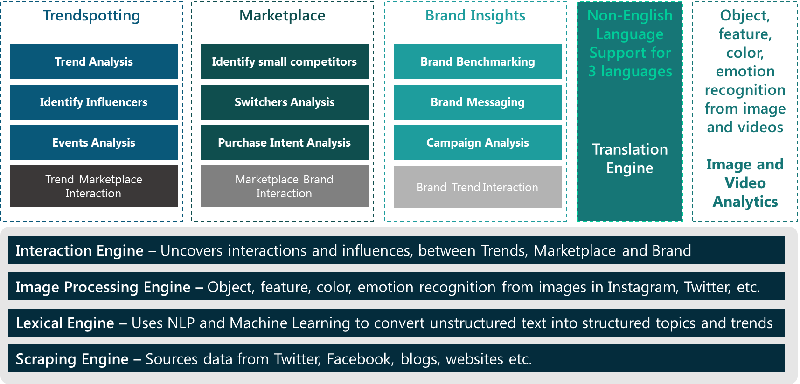
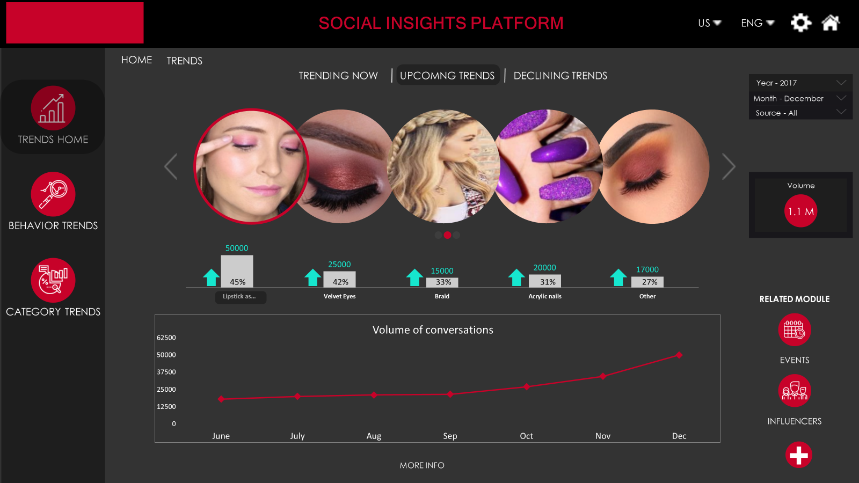
Social Insights Platform for Fashion Trends Spotting
Leading US Cosmetics Company
BI Tool : Web Tool
The Problem: Understanding the make-up and personal care needs of the women in the 18-34 age range is critical in the cosmetics industry
The “Before” State
LatentView Solution
The “After” State
Loyal consumers of the client’s cosmetics line was aging and the impression of the brand had been in steady decline among younger women for the past few years
Building a social insights platform to mine the rich data of the target demographic available in social media to spot trends, rate influencers, identify upcoming competitors, refine campaign messaging and understand drivers of purchase
Ability to score trends that could become mainstream ahead of time helped the company to improve their product launch success rate by 5% in the first 6 months
Notes:
Revlon – Trendspotting

Slide 24
Thank you
Email: Mahadevan.Balakrishnan@latentview.com
Phone: +91 44 4344 1718

Slide 25
Appendix
LatentView Confidential

Slide 26
Integration of Data from Multiple Sources for Data Harmonization & Visualization
LatentView Confidential

Slide 27
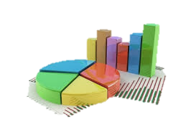
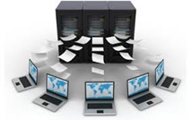
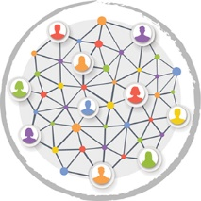




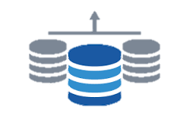
Integrating Data from Multiple Sources
DATA COLLECTION
DATA HARMONIZATION
DATA VISUALIZATION OF KPI’s
Data is collected from multiple sources that are required for the development the required dashboards / reports :
Internal Data
External Data
All the collected data from different sources are loaded in the form of a data mart / data cube. This can be done in one of the following two ways :
In House Data Base
Using Cloud
Visualization of the requested KPI’s can be developed in any of the listed platforms which will enable comparison of multiple channels and summary of performance metrics :
Tableau / Domo Dashboard
Excel Report
Web Tool

Slide 28
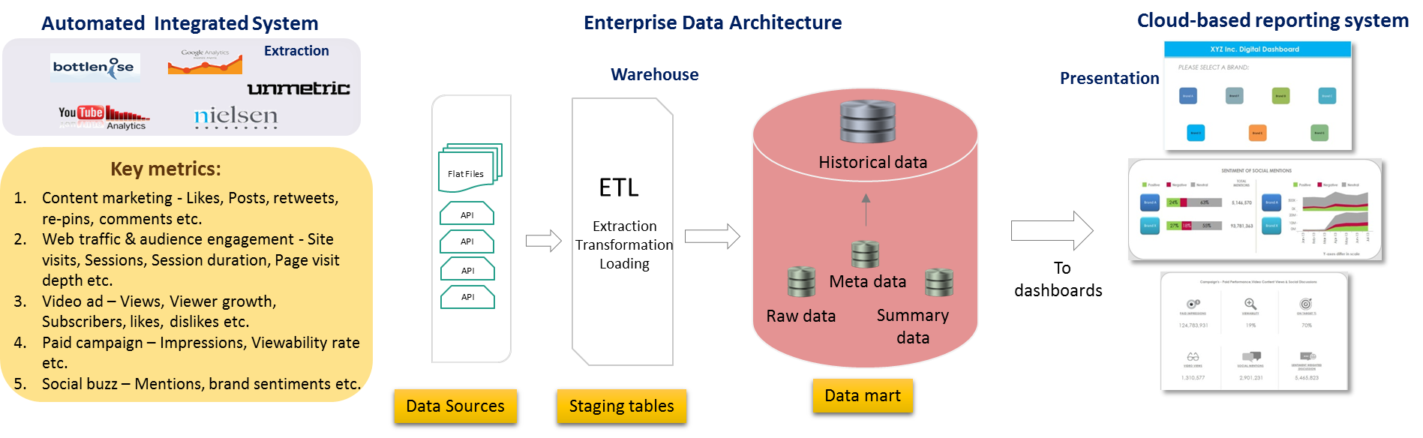
360-Degree View of Digital Metrics to Improve Marketing Effectiveness
Leading Global Food & Beverages Corporation
The “Before” State
In the CPG industry, lack of a unified view of marketing data can result in incorrect analysis and wrong conclusions
Siloed platforms provided a disjointed view of marketing effectiveness resulting in a protracted test cycle for campaigns
LatentView Solution
Built an integrated dashboard with paid, earned and owned media metrics that facilitates cross-channel, cross-brand and cross-campaign comparison to gain deeper marketing insights
The “After” State
Test cycle for campaigns reduced by 25%, thus resulting in a decrease in cost per campaign by as much as 8%
Notes:
Pepsi - DigiView
Business Objective:
To build a single-viewed automated real-time application that enables CXOs to make quick data-driven insights from a company’s digital & social marketing efforts that cut across their Paid, Earned & Owned media spectrums.
LatentView Solution:
Integrated data from five different data sources and built 11 comprehensive interlinked dashboards that give both a snapshot view and a deep dive view of their trademarks’/brands’ online presence, content marketing messages, customer perception and campaigns’ performance within their portfolio & against their competitors.
Business Benefits:
Automated real-time business intelligence application provided the client an opportunity to view their brands’ social & digital marketing efforts in visually appealing & feature-rich Tableau dashboards.

Slide 29
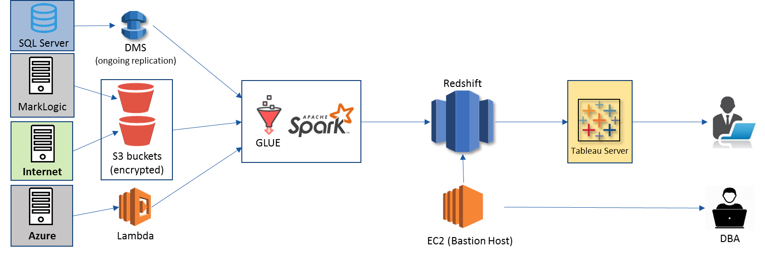
Data Harmonization for Efficient Digital Supply Chain
World’s Largest Entertainment production company
The “Before” State
The supply chain starting from digital content request to going live is tracked using multiple silo data sources and requires skilled executives to monitor for revenue leaks
LatentView Solution
Built an data ecosystem from multiple disjointed unstructured and structured data sources by leveraging AWS cloud platform for big data, thus providing a monitoring platform
The “After” State
The solution helped in ensuring on-time delivery of the digital contents and thus, saved half a million dollar per year from revenue leaks
Notes:
Warner Bros – Digital Supply Chain (Data Engineering)

Slide 30
LatentView- Data Engineering Capabilities
Applications
Data Strategy
Data Lakes
Data Warehouse
Visualization
Decision management systems
IoT Applications
Data Monetization Roadmap
Cloud Strategy & Architecture
Architecture Evolution
Data Integration / Consolidation / Harmonization Framework
Optimizing BI Investments
Data Engineering
Capabilities
Technology
Engineering
Hadoop: Hive, HBase, MapReduce, PiG, HDFS, Phoenix
Spark – Scala, Python, Spark SQL
Flume, Kafka, NiFi, Sqoop
Spark Streaming, Storm
AWS, Azure, Kylo, Qubole, Databricks
Structure Data Flows
Ingest streaming & batch data
Data storage and data model
Batch and Real time processing
Real-time, Graph, Search & Iterative workloads
Orchestration
OCM & Managed Services
Organizational Change Mgmt
Governance
Maturity Assessments

Slide 31

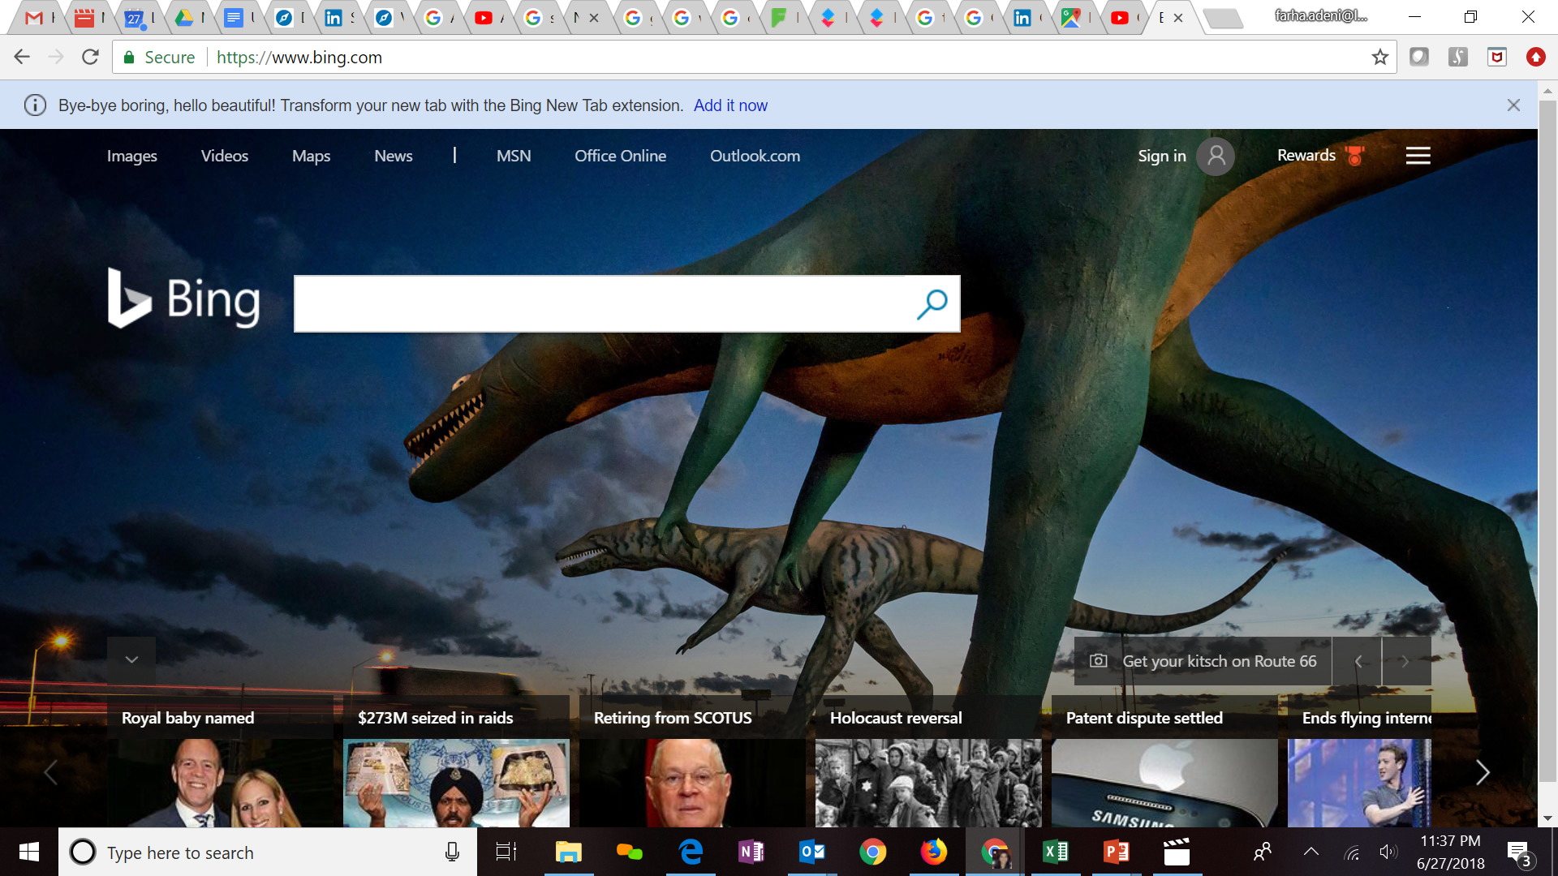







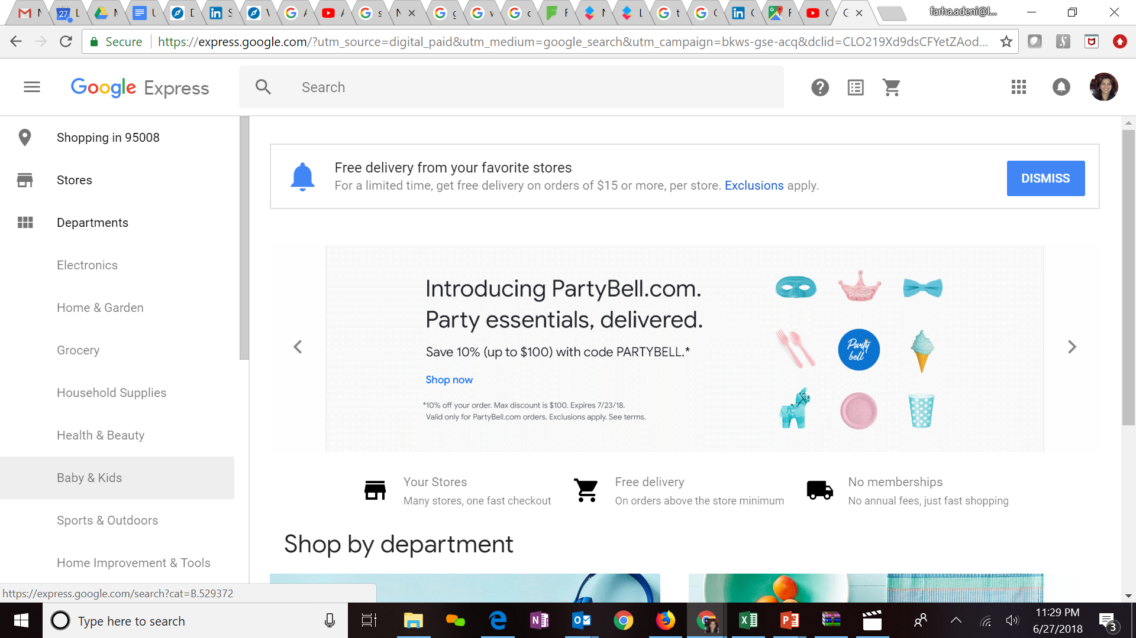

Expertise in Cloud platforms
Key Clients
LatentView is a Microsoft Gold Analytics Partner
Model Automation Framework – LatentView scalable ML solution built in Azure hosted on Microsoft Appsource (link)
Key Participants of MS Tech-ED 2014, Azure Training
Managed Analytics in Azure using AzureML, PowerBI, Azure data factory, Azure Search, Azure data lake analytics etc.
LV is Advanced Analytics Consulting Partner
Key Presenters of AWS Re-Invent, Business Summit
60 TB cloud migration exercise completed in 3 months
Processing 500+ GB unstructured data per week
Multiple enterprise solutions deployment experience
Managed Analytics in AWS using Amazon ML, Cloudsearch, Kinesis, QuickSight etc.
Extensive experience in handling GCP products- AppScript, CloudSQL, Appmaker, Big Query etc. Deep Technical Capabilities to work in this platform
Multiple solutions deployment experience for Google projects
Managed Analytics in GCP using MapR, Cloud ML, Cloud dataflow, Google data studio, Cloud SQL
Notes:
Q – Anup can you update some of the details

Slide 32
Iterative Framework
1. Business Understanding
3. Wireframe Design
2. Data Understanding
4. Dashboard Design & Development
Testing
Unit test
Data check
Data Manipulation
Enhancement-I
Review-I
Enhancement-II
Review-II
Enhancement-III
Review-III
4.a. ETL Team Testing
4.b. Business User Testing
4.c. UAT Testing

Slide 33
Enabling the data driven decision making journey by…
…getting the data together
…making sense of the data
...applying AI & ML to drive impact
Data Acquisition
Acquiring & consolidating the disparate data sources.
Data Engineering
Integrating various forms of data into centralized data lake using on-premise & cloud based technologies
Data Processing
Process various forms of disparate data – Structured, Unstructured, Physical, Human Interactions, Machine Generated, Real Time etc
Graph Analysis
Exploration of frequency, strength and direction of relationships & Causalities.
Exploratory Analysis
Deep insights from all forms of data using traditional methods (Segmentation & Clustering)
Natural Language Processing
Analyze dimensional insights & relationships by automated tagging
Real Time Analytics
Experience in sub-second big data processing for real time applications
Deep Learning & AI
Self governing systems leveraging AI & eliminating manual intervention
Machine Learning
Deep experience with various machine learning algorithms, including Ensemble Learning, Neural Networks, etc.

Slide 34


Integrating Data from Multiple Sources
How to acquire data?
How to create a unified data view?
How to enable consumption?
Data Integration
CANNED REPORTS
Conventional Data Sources
Structured
SELF SERVICE BI
Unconventional Data Sources
Data Mart / Data Lake
OPERATIONAL
External Data Sources
Unstructured
ADVANCED ANALYTICS
Internal Data Sources
REAL TIME REPORTING
Data Type specific ETL toolset
Workload Aware Compute

Slide 35



Enabling Executive Decisions
Junior Executives
Mid Level Management
C-Level
Deep Dive
Play Book
30 SECOND VIEW
Tracks operational KPIs at most granular levels
Extensive data dimensions to enable downstream reporting
Adhoc Analysis
Dashboards to monitor KPIs at division, channel level
Serves as a platform for managers and analysts to drill down on issues
Multiple filters to simulate scenarios and provide flexibility
Bird’s eye view at geographical level
Quick view on KPIs for C-level executives on different businesses
Helps leadership team monitor and track targets
Business Insights

Slide 36












LatentView Solution for Refining Reporting Structure
Review of KPI’s
Audit Current Reports
Design Wireframes
Data Integration
Schedule user interviews, prepare list of existing reports, their data sources, business users and KPIs
Understand data sources, data flows
Understand detailed wireframe requirements
Define architecture for the data integration layer
Identify business objectives
Understand logical grouping of reports
Iterate on wireframes and review with potential end users
Design the data model for the analysis data mart
Define KPI’s required vs used, and goals
Identify usability and audience for each report to capture business value
Prioritize wireframes based on business needs and complexity of implementation
Recommendations on Data Integration process for report deployment on pentaho
Net difference: Promoters vs. Detractors
18%
Identify gaps in KPIs & segments in the context of current reports
Recommend a new set of reports that helps achieve the objectives

Slide 37










1. Getting the data together
How to acquire data?
How to create a unified data view?
How to enable consumption?
Structured Data
External / Internal
Customer Data
Web Data
Data Integration
METRIC & EXCEPTION
REPORTS
Marketing Data
Structured
Payment Data
Data store pipelines enables metric & exception reporting
App Data
INTERACTIVE VISUALIZATON
Data Lake
Dispute Information
API endpoints enabling integration with
other systems
OPERATIONAL
Unstructured Data
External / Internal
Voice Data
Unstructured
ML / AI Workbench for
Prediction & Insights
Chat Data
ADVANCED
ANALYTICS
Email Data
Biometric Data
Social Data
Other data sources

